Slide 1

Project – Final Presentation
Software Engineering 2 – A.Y. 2015/2016
Jovanovic Milica 835953
Vidanovic Pavle 854472
POLITECNICO DI MILANO

Slide 2
RASD
Software Engineering 2 – A.Y. 2015/2016
POLITECNICO DI MILANO

Slide 3

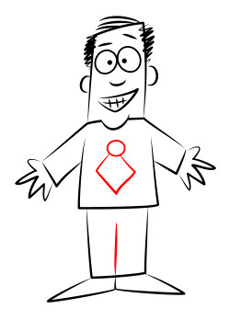
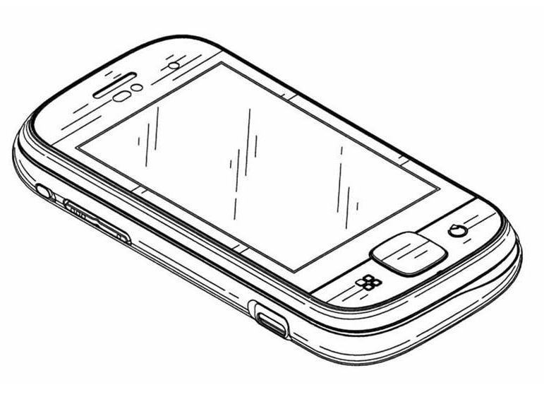

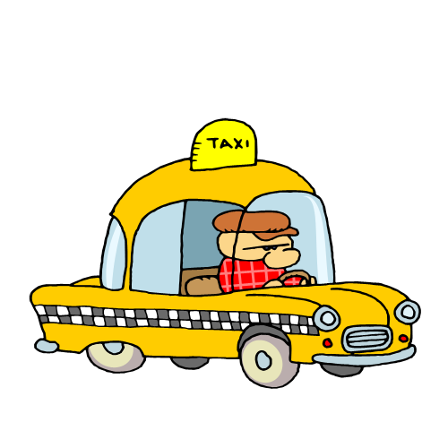
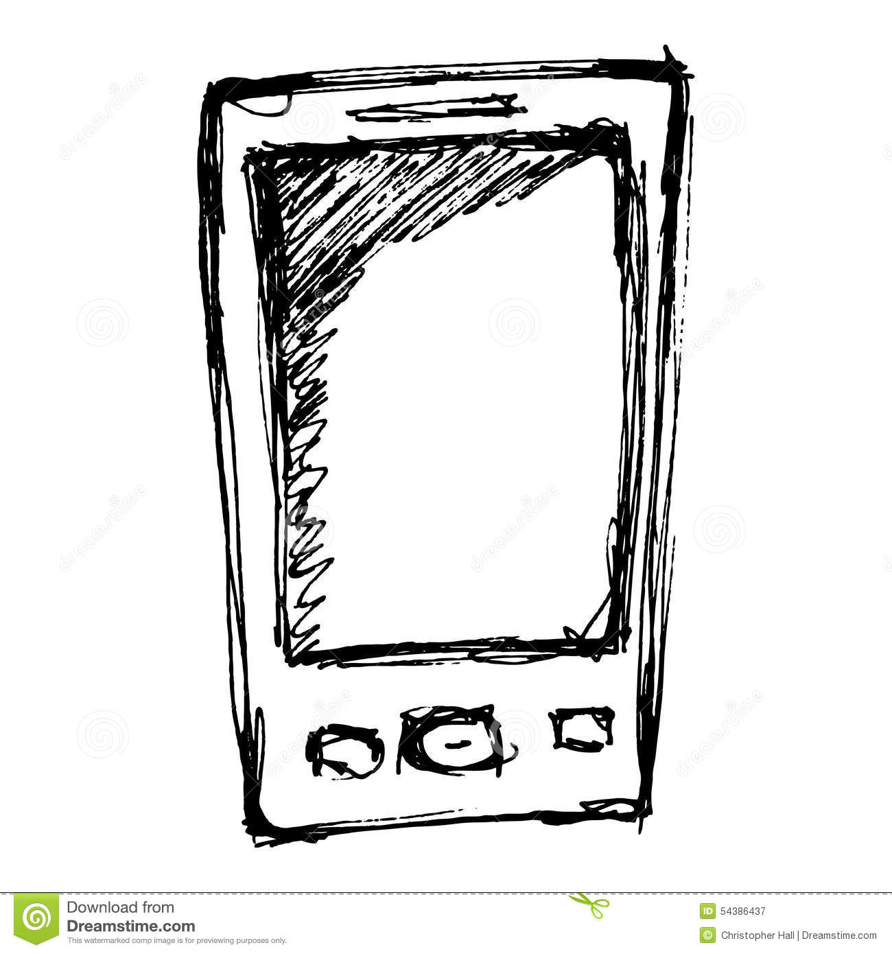
myTaxiService software application
Application similar to Uber, which makes the process of assigning an available taxi vehicle to possible passengers
POLITECNICO DI MILANO

Slide 4
Overall description
Stakeholders:
Company
- provided project specification
- expect it to be delivered in a way that satisfies given specification
- respecting the set deadlines and budget
Developer group
Taxi driver
- person working for the company that ordered the software product
Passenger
- person who need a ride to specific location
Actors:
Guest - person accessing a system that has either never registered of hasn't logged in yet
User - person already registered and logged into the system
Taxi driver - same as User, but can access to all features offered by the driver application
Admin - person responsible for handling reports, can ban users or driver from system
POLITECNICO DI MILANO

Slide 5
Overall description
Goals:
[G1] registering new user
[G2] login to existing user’s account
[G3] managing user's profile
[G4] requesting a taxi
[G5] reserving a taxi
[G6] canceling a ride
[G7] checking taxi availability around user
[G8] reporting a problem caused by passenger or taxi driver
[G9] confirming/declining a ride(taxi driver)
POLITECNICO DI MILANO

Slide 6

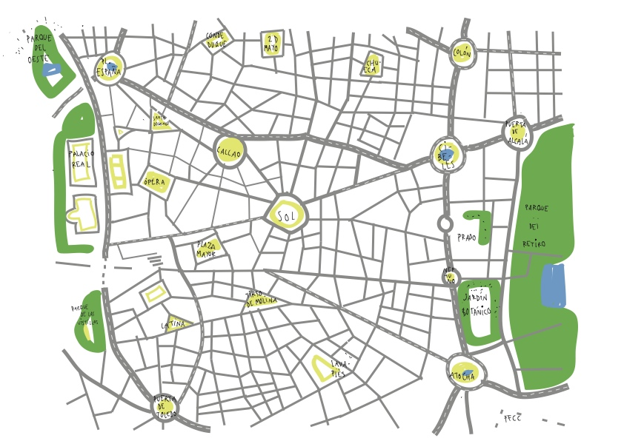
Overall description
Domain properties - these conditions hold in the analyzed world:
the passenger needs a ride to specific location
the details of the ride provided by the passenger are accurate
money exchange between the passenger and the taxi driver is made independently from the myTaxiService system
distinction between the zones are clearly defined
POLITECNICO DI MILANO

Slide 7
Overall description
Constraints
Regulatory policies - will not take advantage of users personal information and will respect the privacy policy
Hardware limitation - access to Internet and own a device with a web browser and GPS service
Interfaces to other applications - Google Maps API, Google Places API and email service in order to make authentication
Parallel operation - support parallel access to the applications database in a transparent way
Assumptions
user have only one account
- user provides accurate information
- if users location is not available, the application will show a screen with an option of typing your current address
- we assume that Google Maps service will calculate location accurately
- taxi driver will respect the ETA, otherwise they could be banned from the system
- if a taxi driver has an unexpected issue, the user will be automatically notified by the system and a new vehicle will be assigned to him with new ETA
POLITECNICO DI MILANO

Slide 8
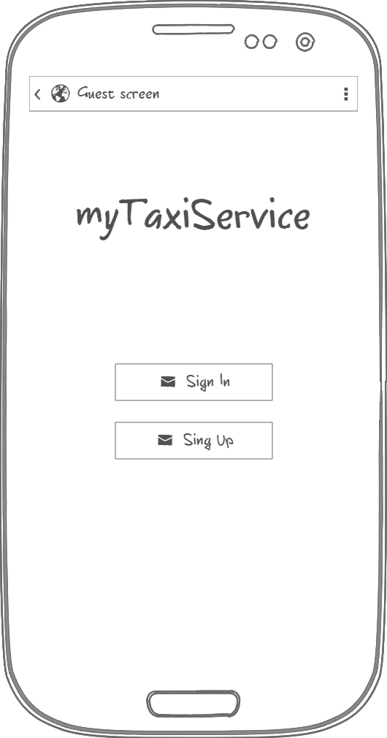
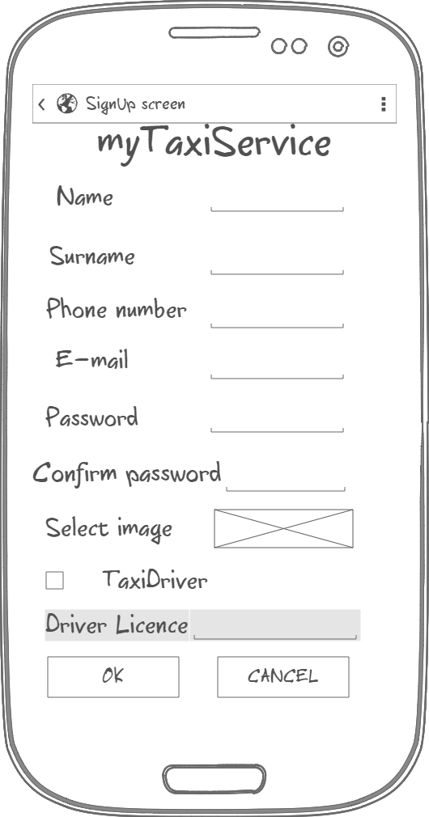
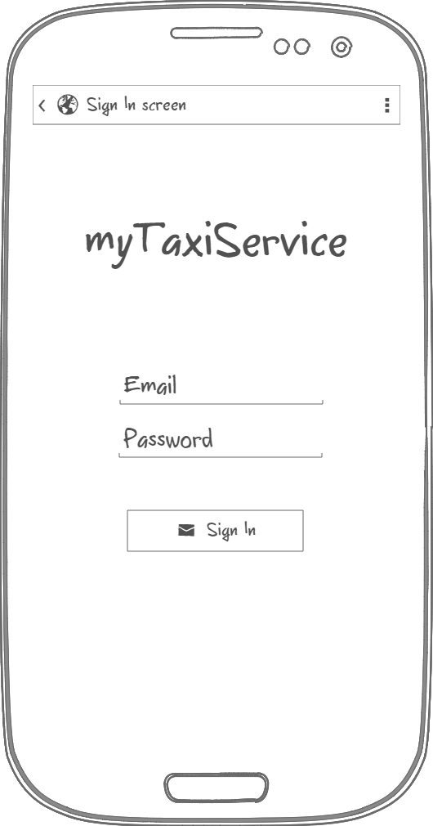
Specific requirements - Mockups
Initial page
Sign Up
Sign In
POLITECNICO DI MILANO

Slide 9
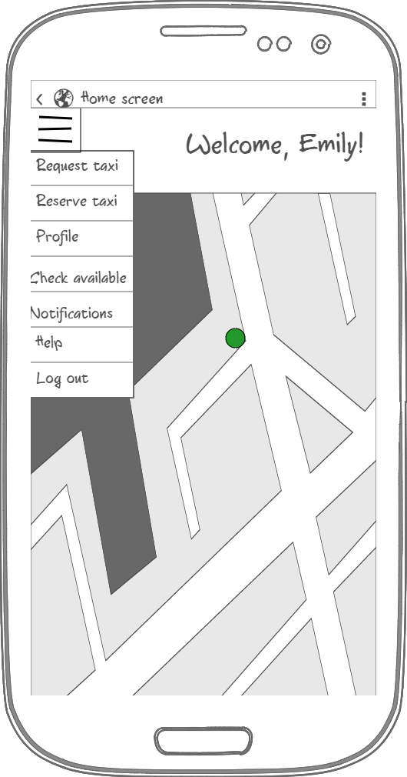
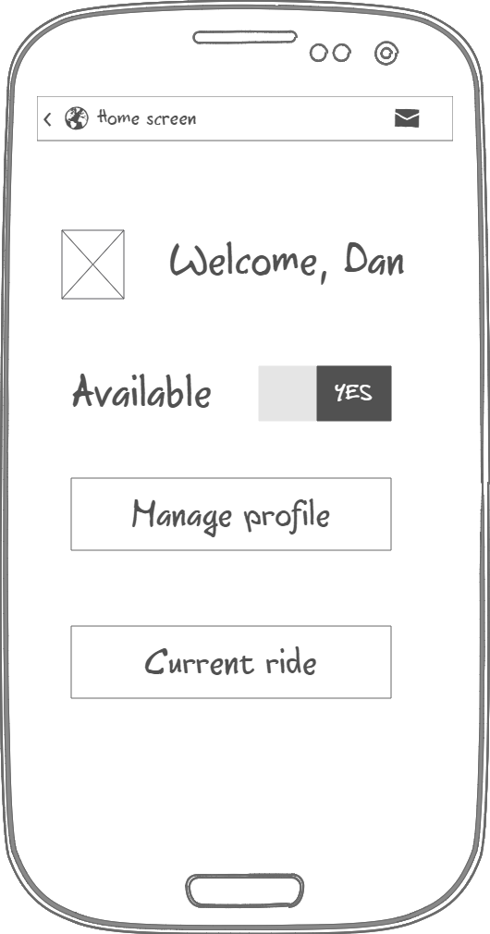
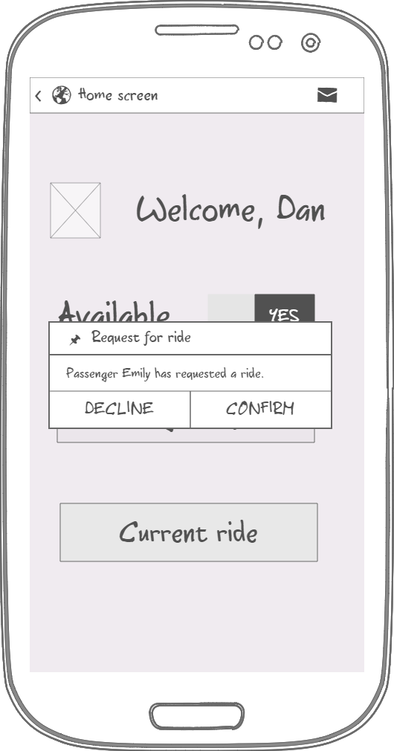
Specific requirements - Mockups
Driver application
Passenger Home page
Driver Home page
Pop up message
POLITECNICO DI MILANO

Slide 10
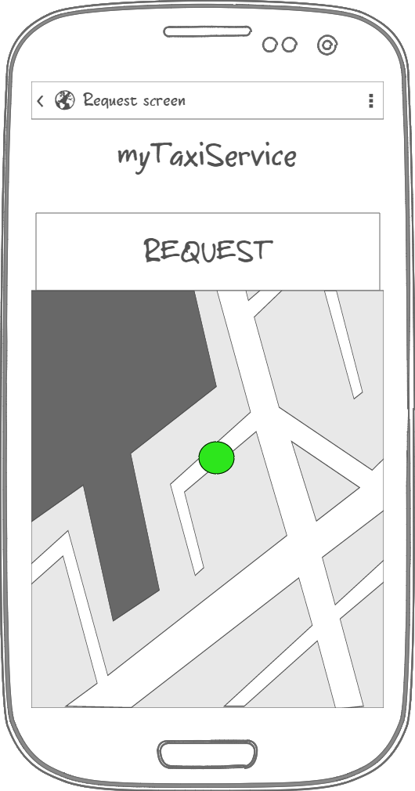
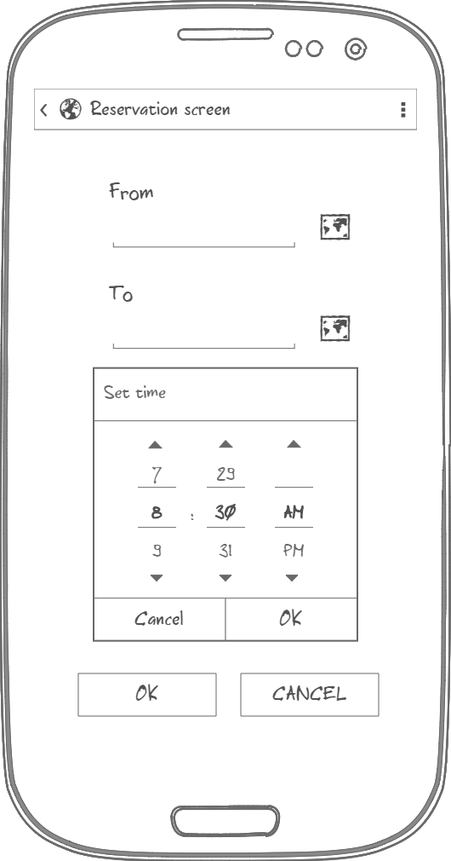
Specific requirements - Mockups
User specify location either by typing address or by choosing it on the map
User specifies address by clicking on the map
Passenger Request page
Passenger Reservation page
POLITECNICO DI MILANO

Slide 11
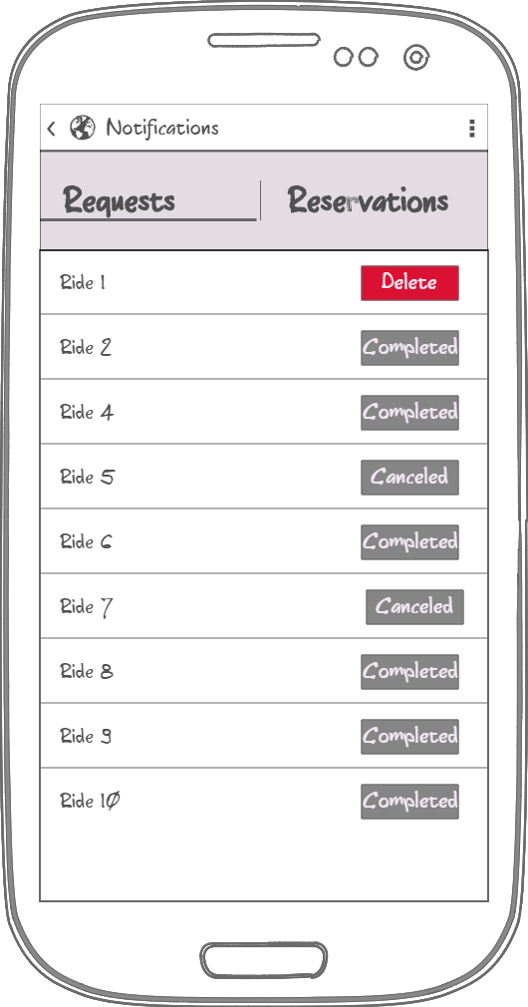
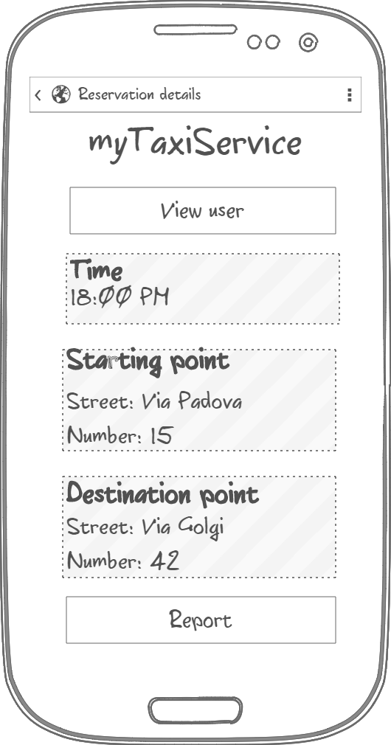
Specific requirements - Mockups
User rides with an option of canceling active ones
Reservation Details page with data
Notification page
Reservation details
POLITECNICO DI MILANO

Slide 12
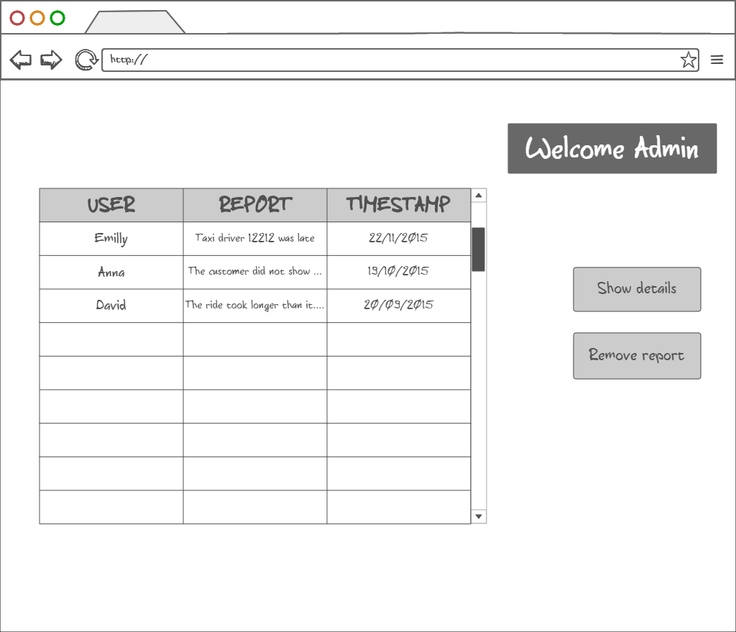
Specific requirements - Mockups
Admin home page
Show details action brings Admin to Report details page
POLITECNICO DI MILANO

Slide 13
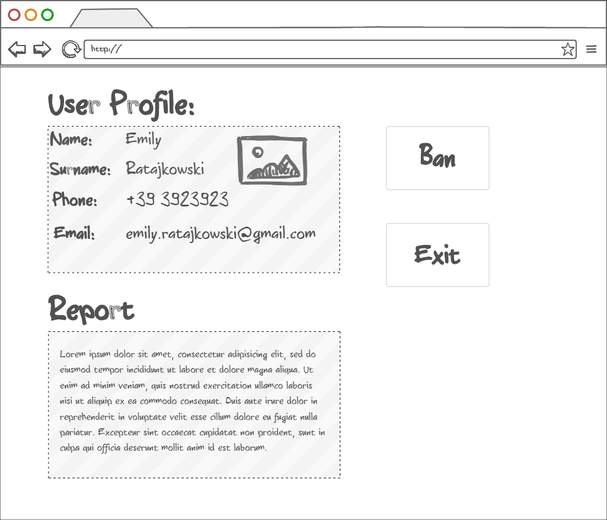
Specific requirements - Mockups
Admin report details page
Information about the user that made the repot
Bans reported user from the system
POLITECNICO DI MILANO

Slide 14
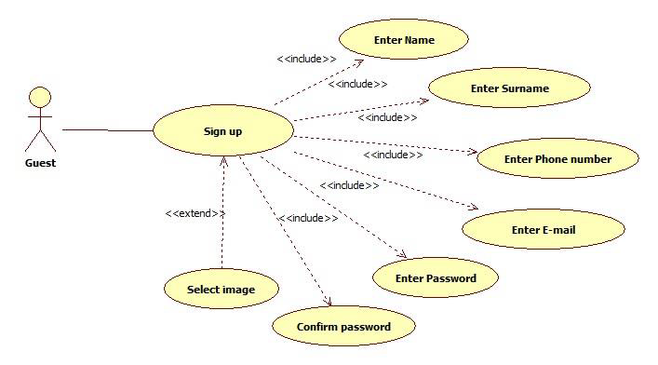
Specific requirements - Use cases
Sign Up use case
POLITECNICO DI MILANO

Slide 15
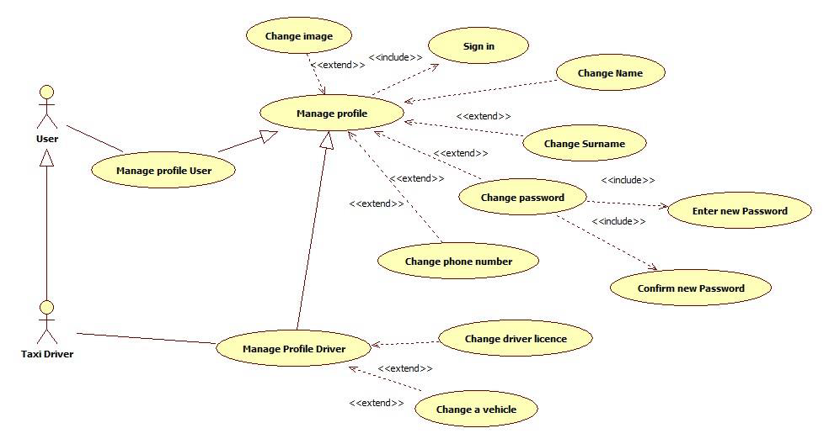
Specific requirements - Use cases
Manage profile use case
POLITECNICO DI MILANO

Slide 16
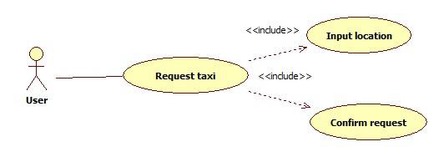
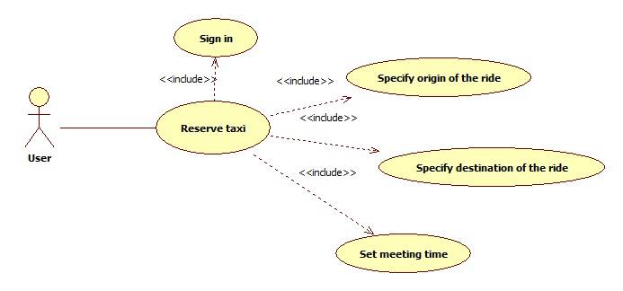
Specific requirements - Use cases
Request / Reserve a taxi use case
POLITECNICO DI MILANO

Slide 17
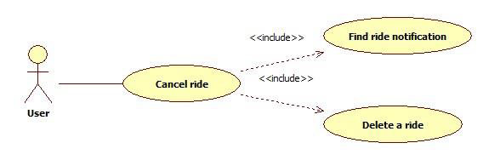
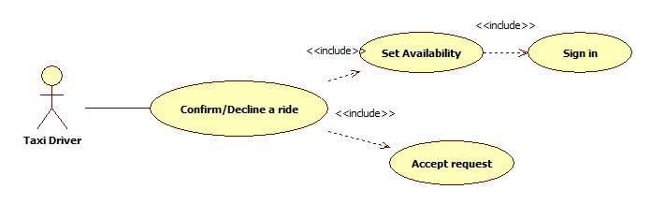
Specific requirements - Use cases
Use cases
Cancel ride use case (passenger)
Confirm/Decline a ride use case
POLITECNICO DI MILANO

Slide 18
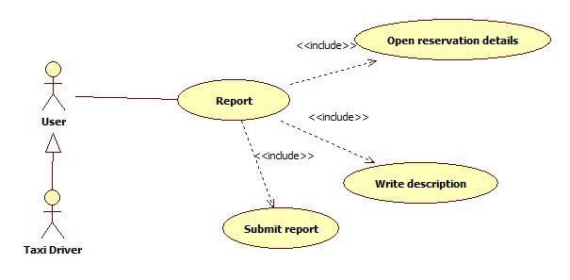
Specific requirements - Use cases
Report use case
POLITECNICO DI MILANO

Slide 19
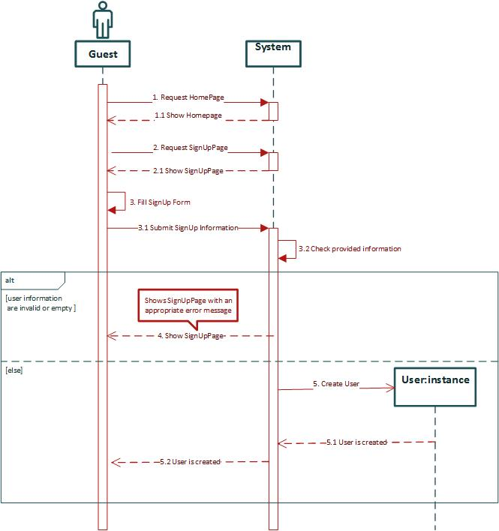
Sign Up sequence diagram
Sign Up sequence diagram
POLITECNICO DI MILANO

Slide 20
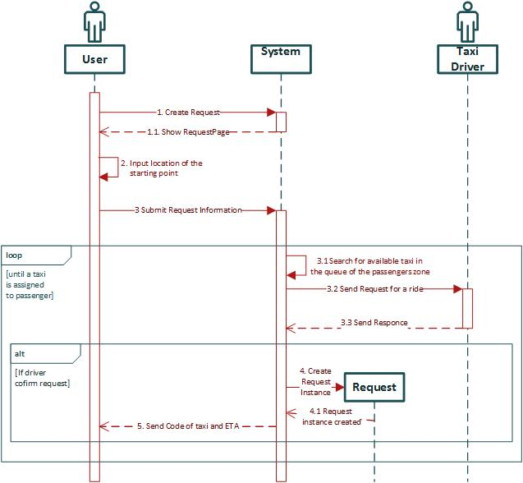
Request a taxi sequence diagram
POLITECNICO DI MILANO

Slide 21
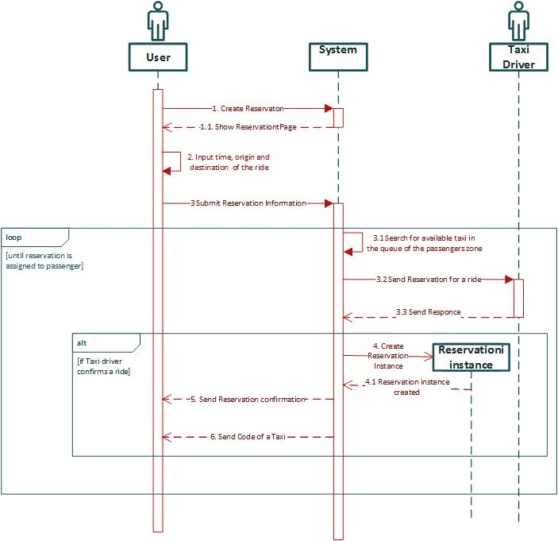
Reserve a taxi sequence diagram
POLITECNICO DI MILANO

Slide 22
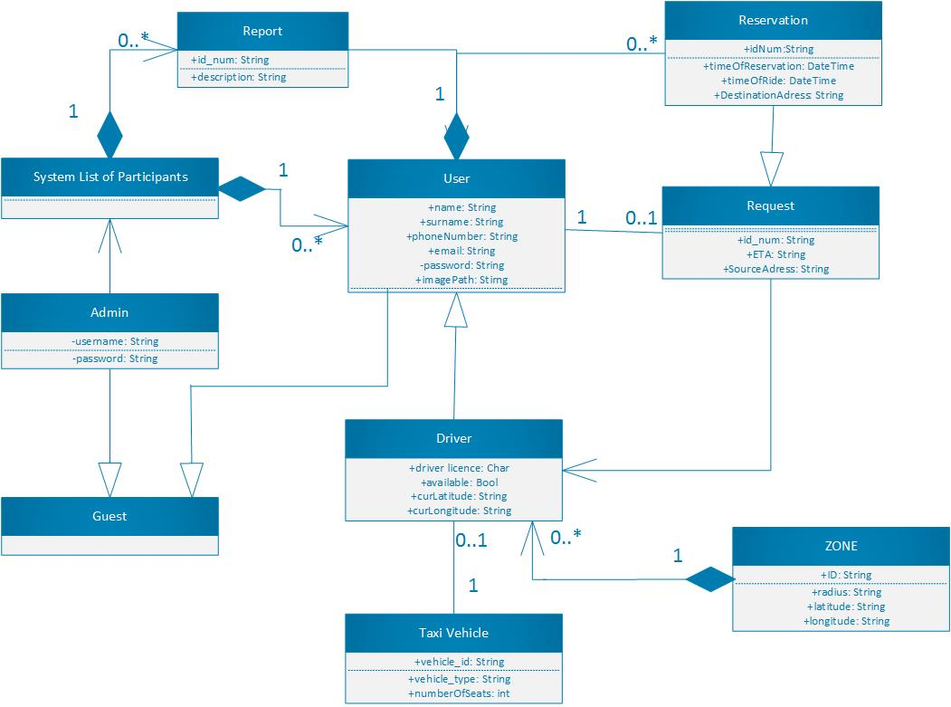
Specific requirements – Class diagram
POLITECNICO DI MILANO

Slide 23
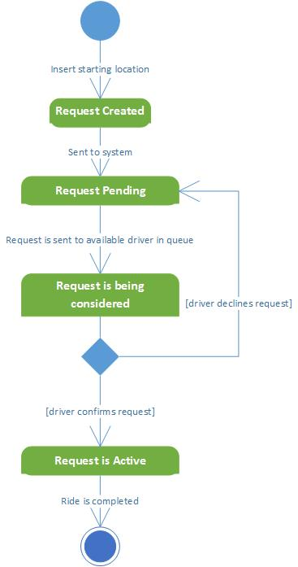
Specific requirements – State Chart diagrams
Request lifecycle
POLITECNICO DI MILANO

Slide 24
Specific requirements – Non functional requirements
Availability
-Application should be available to handle user's request at all times using any device with an installed web browser
Maintainability
- The software system provide specific API for enabling future developers with option to add more services or fix bugs in the system
Portability
- Application could be run on device with any OS that has access to Internet and has a web browser
User Interface
- Web application should be intuitive so even the nontechnical users can use the system as simply and efficiently as possible
POLITECNICO DI MILANO

Slide 25
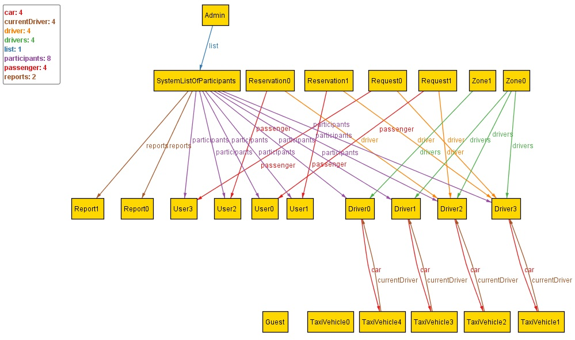
Alloy- World generated by Alloy analyzer
POLITECNICO DI MILANO

Slide 26
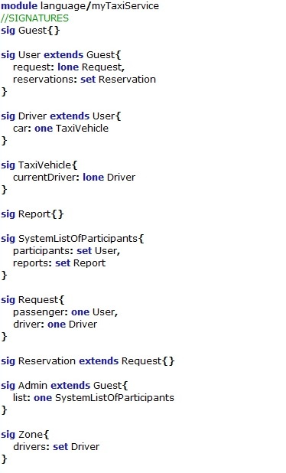
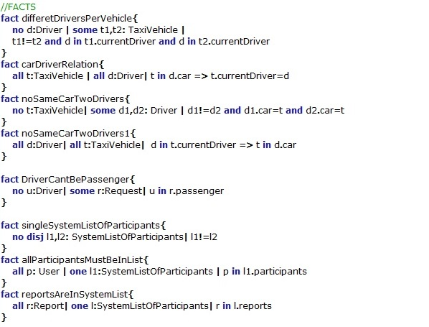
Alloy- Prove the model’s consistency
POLITECNICO DI MILANO

Slide 27
Design Document
Software Engineering 2 – A.Y. 2015/2016
PAVLE OVDE IDE DD ☺
POLITECNICO DI MILANO

Slide 28
Integration Test Plan
Software Engineering 2 – A.Y. 2015/2016
POLITECNICO DI MILANO

Slide 29
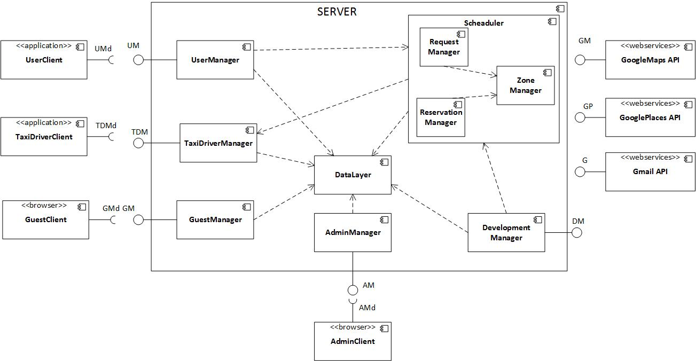
System Components - Overview
POLITECNICO DI MILANO

Slide 30
Functions that have to pass unit testing 1/2
Component | Functions to be unit tested
Guest Manager | signUp() signIn()
User Manager | makeRequest() makeReservation() report() manageProfile() checkTaxisAvailable() checkReservation() cancelRide()
TaxiDriver Manager | confirmDeclineRide() setAvailable() manageProfile() report() cancelRide() checkRides()
Admin Manager | banUser() viewReports() signIn()
Scheduler
POLITECNICO DI MILANO

Slide 31
Functions that have to pass unit testing 2/2
Component | Functions to be unit tested
Request Manager | createRequest() provideTaxi() calculateETA() sendConfirmation() findZone() findDriver() rideProposal()
Reservation Manager | createReservation() findDriver() findZone() sendConfirmation() reservationConfirmation() rideProposal()
Zone Manager | determineZone() //getZone findAvailableDriver() enqueDriver() dequeueDriver() peekDriverOnQueue()
POLITECNICO DI MILANO

Slide 32



Elements to be integrated 1/3
Admin Component
Guest Component
Taxi Driver Component
POLITECNICO DI MILANO

Slide 33
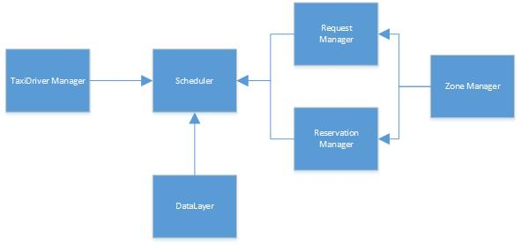
Elements to be integrated 2/3
Scheduler Component
POLITECNICO DI MILANO

Slide 34
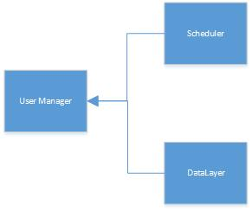
Elements to be integrated 3/3
User Component
POLITECNICO DI MILANO

Slide 35
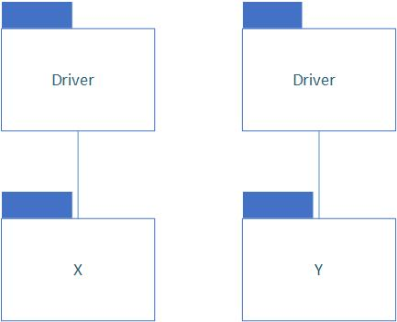
Integration Strategy – Bottom up
bottom-up approach
start from the lowest levels of the system (functions) that have passed the unit testing
good overview of how far have we gone with the integration testing
spot the problems in lower levels
POLITECNICO DI MILANO

Slide 36
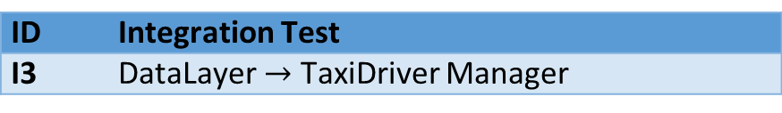
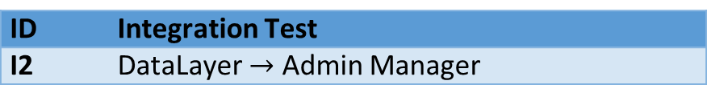
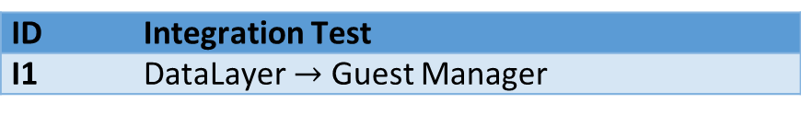
Software Integration Strategy 1/2
ID | Integration Test
I1 | DataLayer $→$ Guest Manager
ID | Integration Test
I2 | DataLayer $→$ Admin Manager
ID | Integration Test
I3 | DataLayer $→$ TaxiDriver Manager
Integration Test for:
Guest Component
Admin Component
TaxiDriver Component
POLITECNICO DI MILANO

Slide 37
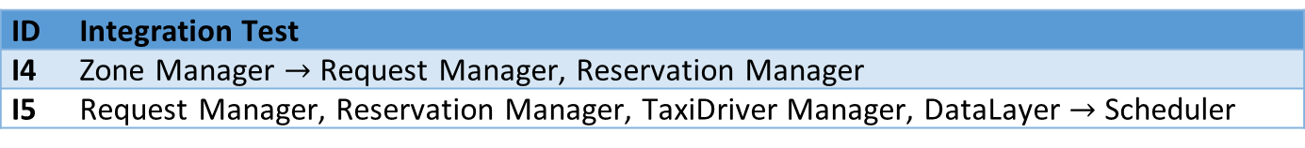
Software Integration Strategy 2/2
ID | Integration Test
I4 | Zone Manager $→$ Request Manager, Reservation Manager
I5 | Request Manager, Reservation Manager, TaxiDriver Manager, DataLayer $→$ Scheduler
ID | Integration Test
I6 | DataLayer, Scheduler $→$ User Manager
Integration Test for:
Scheduler Component
User Component
POLITECNICO DI MILANO

Slide 38
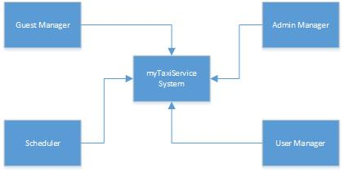
Subsystem Integration
ID | Integration Test
I7 | Guest Manager, Admin Manager, User Manager, Scheduler $→$ myTaxiSevice system
POLITECNICO DI MILANO

Slide 39
Test Cases Specification
POLITECNICO DI MILANO

Slide 40
Test Procedures
POLITECNICO DI MILANO

Slide 41
Tools and Test Equipment
Manual Test
Implementation is splitted by user stories
Integration testing is done manually by the same team member who has implemented it
Then it is tested by other team member to ensure that all the requirements are met
Automatic Test
save time in long term: it can be
run in every moment
everybody can check reports
“Cucumber”
“Watir-Webdriver”
Used programming language for writing the code for test cases is Ruby
POLITECNICO DI MILANO

Slide 42
Program Stubs and Test Data Required
Manual Test
POLITECNICO DI MILANO

Slide 43
Project Plan PAVLE
Software Engineering 2 – A.Y. 2015/2016
POLITECNICO DI MILANO

Slide 44
Future possible implementation
Online payment
Option of rating the drivers
Facebook authentication
Taxi sharing options
POLITECNICO DI MILANO

Slide 45

Questions?
Thank you for your attention
POLITECNICO DI MILANO

